Slide 1
MachineVisionAR
Alexander Solomon

Slide 2
What is MachineVisionAR?
A software platform that utilizes 3D models to generate synthetic data for training object detection models
A screenshot of the home menu of the MachineVisionAR desktop app
Notes:
Accessibility to AI and machine learning tools are rapidly advancing.
General AI models, like ChatGPT are trained on vast datasets covering a broad range of general knowledge.
These general AI models are extremely impressive, but they might not suit highly specialized or unique cases.

Slide 3
Challenges in Traditional Data Gathering
Scarcity and Inaccessibility
High Costs and Time Consumption
Privacy and Ethical Issues
Data Quality and Bias
Notes:
- Acquiring large volumes of real-world data can often be difficult (rarity, safety, privacy).
- Tasks like setting up sensors, recruiting participants or manual labeling
- Real-world data may contain sensitive information, restricting its use for AI training
- Quality of data can be inconsistent, and if not representative, can lead to biased AI models
- Consider the challenges in an area like autonomous driving or robotic surgery, general datasets are just not enough
- For computer vision and object detection though, we can use synthetic data

Slide 4
Synthetic Data
Definition: Artificially generated data that simulates real-world data but is produced by algorithms or simulations
Purpose in AI: To augment or replace real-world data when it's scarce, private, or expensive to collect
Use Cases: Ideal for training, testing, and validating machine learning models across various industries.
Notes:
Synthetic data is like the scaffolding for a building under construction. It provides the necessary support when the real thing isn’t available
In machine learning, real-world data is invaluable, but it is not always accessible.
Synthetic data fills this gap, allowing us to proceed with model development in its absence

Slide 5
Advantages of Synthetic Data
Control and Customization
Synthetic data allows for control over every aspect of the data, including the creation of edge cases, which can be rare or non-existent in real-world datasets
Scalability and Speed
Algorithms can generate vast amounts of synthetic data quickly and efficiently, scaling to the needs of any project
Cost-Effectiveness
Iterative Development
Synthetic data generation allows for rapid iteration, letting developers refine models quickly based on immediate feedback from generated data
Safety and Privacy
Notes:
One of the key benefits of synthetic data is the control it offers. We can simulate rare and diverse events.
The scalability of synthetic data is unmatched, data is pretty much generated on demand
Because of the speed and customization, we can experiment with different datasets and different models for little to no cost increase

Slide 6
Amazon’s “Just Walk Out” (CPG)
Debuted in 2016
Objective: Enhance the shopping experience by eliminating traditional checkout lines
Technology: Utilizes “Just Walk Out” Technology, integrating computer vision, sensor fusion and deep learning to automatically manage purchases and payments

Slide 7
Role of Synthetic Data
Enhancing Object Detection: Utilizes synthetic data, including 3D models, to train the algorithms for recognizing products in various orientations and lighting conditions
Generative Adversarial Networks (GAN) were used to create synthetic images and video clips that mimicked realistic shopping scenarios with variations

Slide 8
Amazon “Just Walk Out”
Recently Amazon scaled back its Just Walk Out technology and removed it from all Amazon Fresh stores in the US
Just Walk Out faced significant challenges citing cost and slow performance
700 out of 1000 walkouts had to be manually reviewed by remote cashiers in India
Ethical concerns about questionable hiring and privacy practices

Slide 9
Neurolabs ‘ZIA’ (Zero Image Annotation)
Zero Human Annotations
Synthetic Computer Vision (SCV): Generates training data programmatically, reducing costs and eliminating errors from human annotations
Robustness: SCV enhances accuracy by avoiding common pitfalls of traditional Computer Vision methods
Rapid Product Onboarding
ZIA Capture App: Allows quick onboarding of new products, less than 30 seconds per SKU
High Initial Accuracy: Achieves over 96% accuracy immediately, enabling faster catalog updates

Slide 10
Neurolabs ‘ZIA’ (Zero Image Annotation)
Advanced Training Models
Extensive Dataset: Leverages over 2 billion product images and 72 million shelf images.
Continuous Improvement: Models enhance accuracy over time, ensuring up-to-date and reliable catalog management.
Seamless Integrations
Compatibility: Effortlessly integrates with existing infrastructure, including Sales Force Automation systems.
Flexible: Adapts easily across various regions, meeting diverse industry demands.
Enhanced Visibility through ISSU
In-Store Scene Understanding (ISSU): Offers comprehensive insights into the entire store environment, including competitor activities and customer interactions.
Strategic Decision-Making: Enhances visibility and supports more informed strategic decisions

Slide 11
Dassault Système
Dassault Systèmes: a company with deep expertise in digital twins
Digital twin: a digital representation of a physical object, person or process, contextualizecd ina digital version of its environment
Linked to real data sources from the environment, meaning that the twin updates in real time to reflect the original version
Most value comes from reduction in time to market. Digital twins can allow for rapid iterations and optimizations of product designs – far faster than physically testing every single prototype

Slide 12
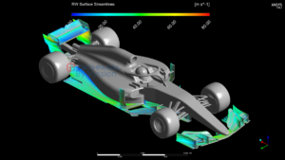
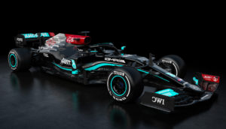

Slide 13
Dassault Systèmes 3DEXCITE
3DEXCITE platform offers high-end 3D visualization tools
Mainly used for marketing, sales and product communications
Able to render photorealistic training data with data augmentation techniques
Zoom in/out
Rotation
Material
Lighting
Flat positioning
Multiple objects in scene

Slide 14
Amazon Rekognition
AI service that enables developers to add image and video analysis to their applications without needing deep expertise in machine learning
Rekogntion Custom Labels allow custom object detection models
Combined with 3DEXCITE synthetic datasets
After 15 iterations, model achieved an F1 score of 98% accuracy using around 10,000 synthetic training images, around 2,000 images per object

Slide 15
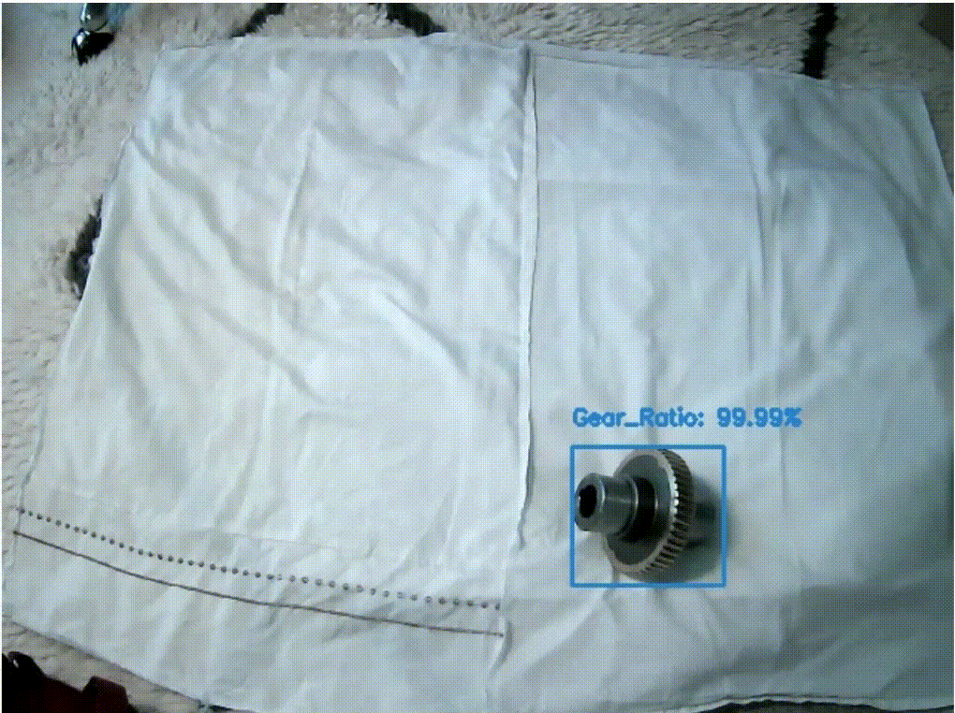

Slide 16
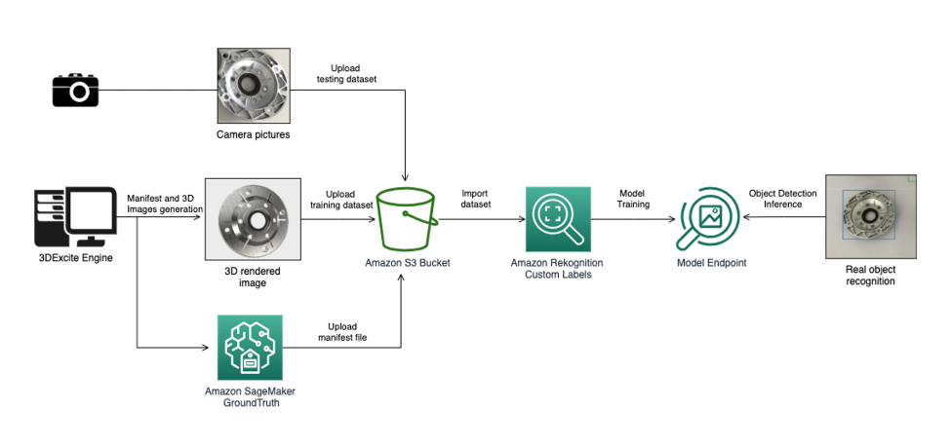

Slide 17
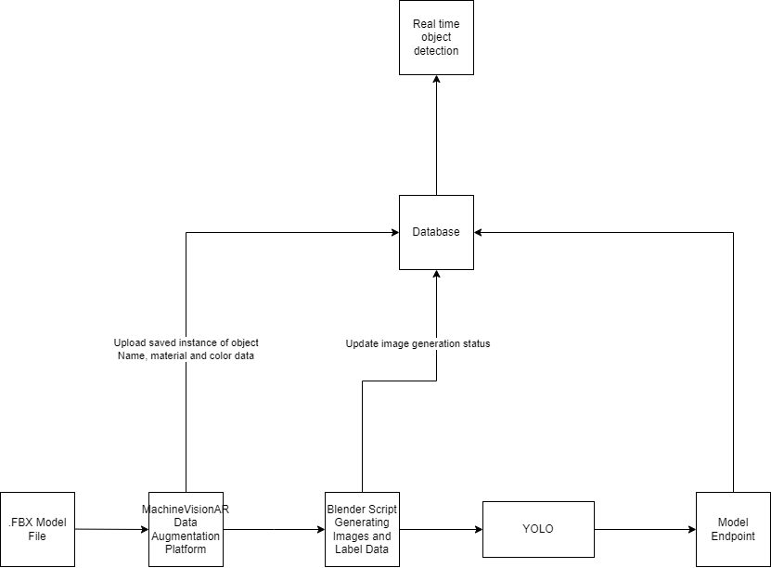
MachineVisionAR

Slide 18
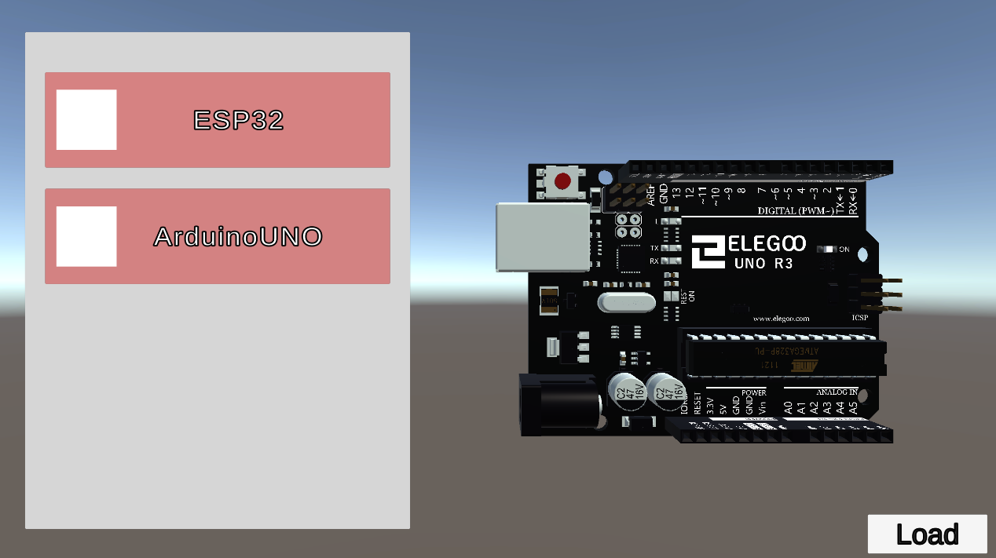
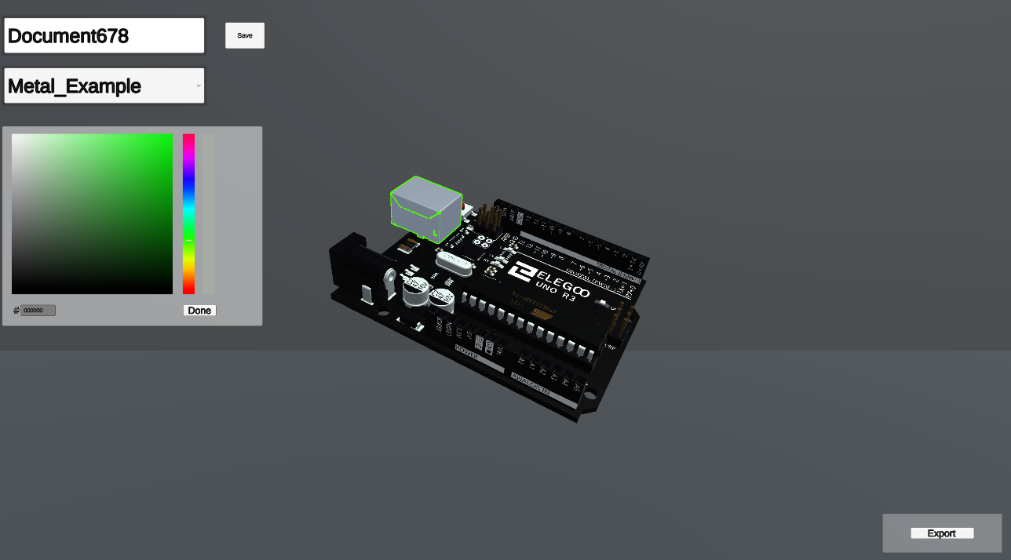
Data Augmentation
The first step in the platform is to upload your 3D model file and begin adjusting the material and color
Can be done in Unity (user friendly)

Slide 19
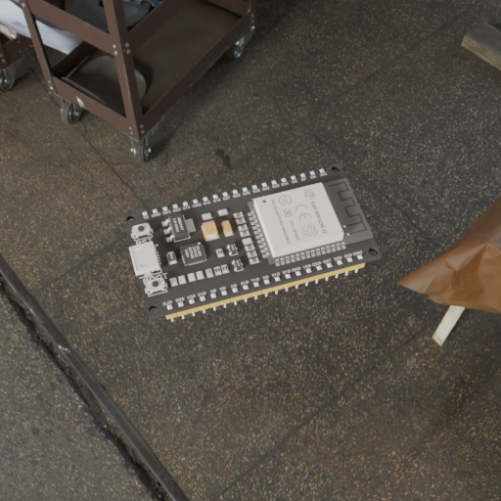
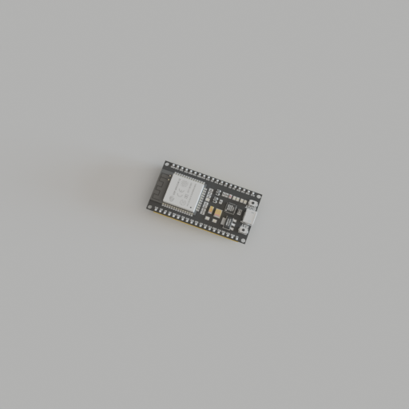
Data Augmentation
Final model is then sent to a data generation script in Blender
Zoom
Rotation
Lighting and background
Flat positioned
Automatic bounding box labeling

Slide 20
Model Training
Model is trained with YoloV8
10,000 images after 25 epochs
Post results

Slide 21
Conclusion and Future
Integration into companies in need of object detection for specialized/rare components

